Slide 1

CHEST X-RAY IMAGES PNEUMONIA

Slide 2

01 OBJECTIVES
03 RESULTS ANALYSIS
02 METHODOLOGY
04 CONCLUSIONS
Problems
Solutions
Model Performance
Quantification and Statistical Analysis
Visualizations
Project Understanding
Data Preparation
What did we gain from the project a what problem we resolved

Slide 3
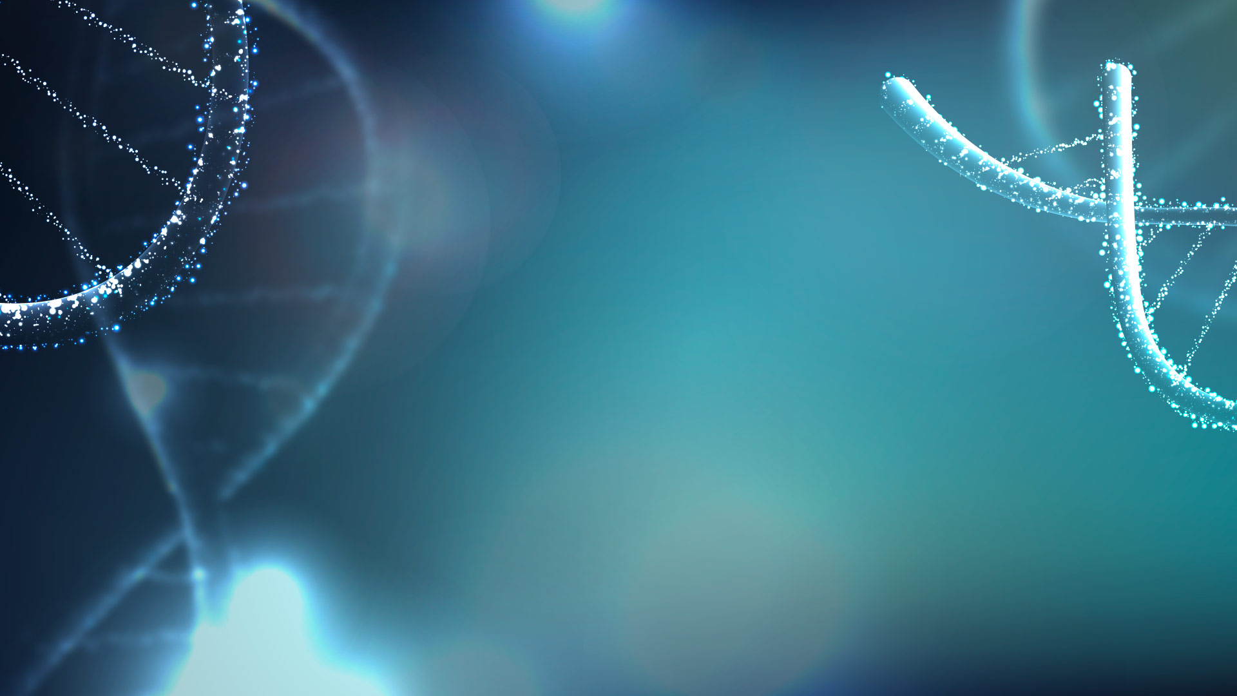
INTRODUCTION
Here, we establish an algorithm based on a deep-learning framework for the screening of patients with common treatable disease pneumonia.
The implementation of clinical-decision support algorithms for medical imaging faces challenges with reliability and interpretability.
In this Project, we sought to develop an effective transfer learning algorithm to process medical images to provide an accurate and timely diagnosis.

Slide 4
OBJECTIVES

Slide 5
Classification of Pneumonia from Chest X-Ray
Parallelize the code on GPU on single or multiple nodes to measure the accuracy, efficacy of the code to classify weather the patient has pneumonia or no- pneumonia based on the patients X-ray images
Create model using Transfer learning on Pytorch using multi-GPU and node
Decreased the running time of training the code

Slide 6
METHODOLOGIES

Slide 7

DATA COLLECTION
DATA REQUIREMENTS
DATA PREPARATION
DATA MODELLING
Collected data is Unstructured image data
No gaps in the collected data
Total 5,860 images
Training: 5,216 images
Testing: 624 images
Balanced and Clean Data
Similar Data in both the classes
Apply simple deep learning architecture
Cleaned and Prepared the data
Preprocess and Balanced the data
Resized the images
Normalizes the images
Converted images into tensor
Applied ResNet50 on the training set to build a model
Trained model on 2 GPU’S and 1 Node

Slide 8
Goal is to parallelize the model using deep learning CNN, Pytorch on MultiGPU and MultiNode.
ANALYTIC APPROACH
We will use Relu as an activation function in the layers. where at last layer. We may use SoftMax as our activation function in order to get the probability

Slide 9
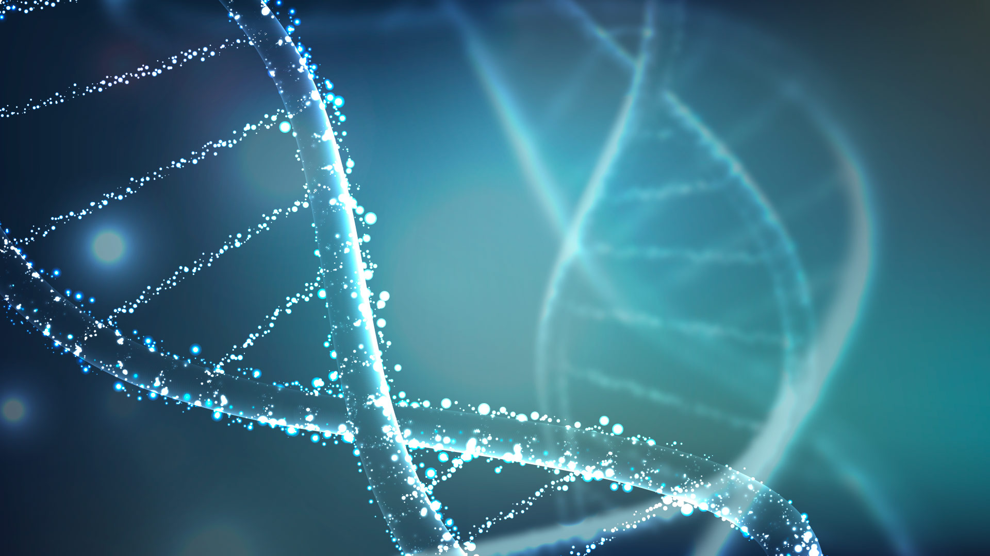
RESULTS ANALYSIS

Slide 10
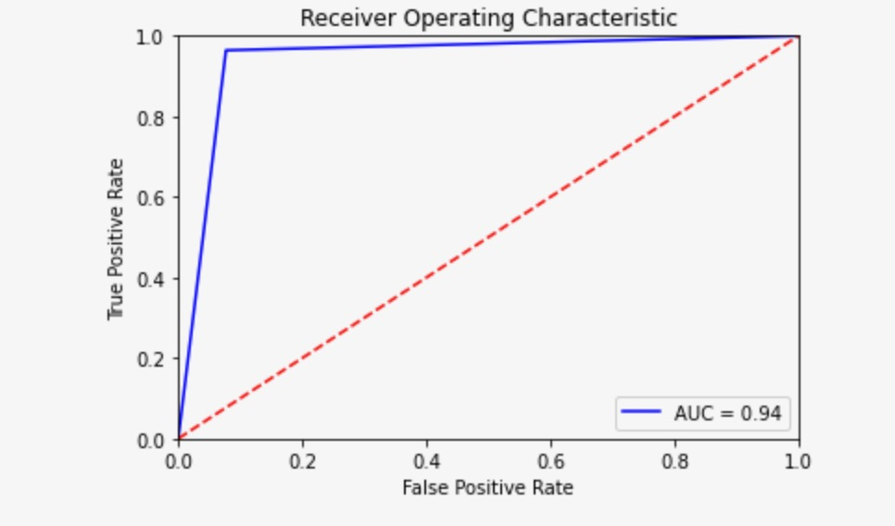
MODEL PERFORMANCE
We achieved an accuracy of 60% with 1 GPU, 1 node for 25 Epoch
We achieved an accuracy of 94.8% with 2 GPU,1 node for 25 Epoch
Receiver operating characteristic (ROC) curves were generated to evaluate the model’s ability. The area under the ROC curve was 94%

Slide 11
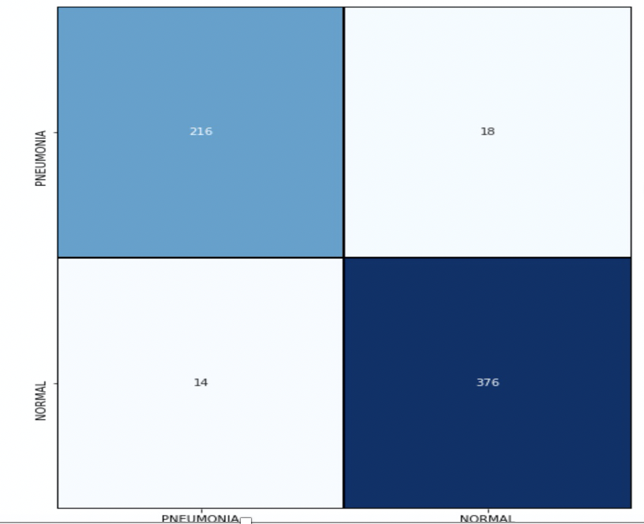
CONFUSION MATRIX
As we can see in the image, total number of true positives are quite high, which helps in improving the recall significantly. Since, it has large number of true positives and very few false negatives which indeed resulted in high recall of 96.4%.

Slide 12
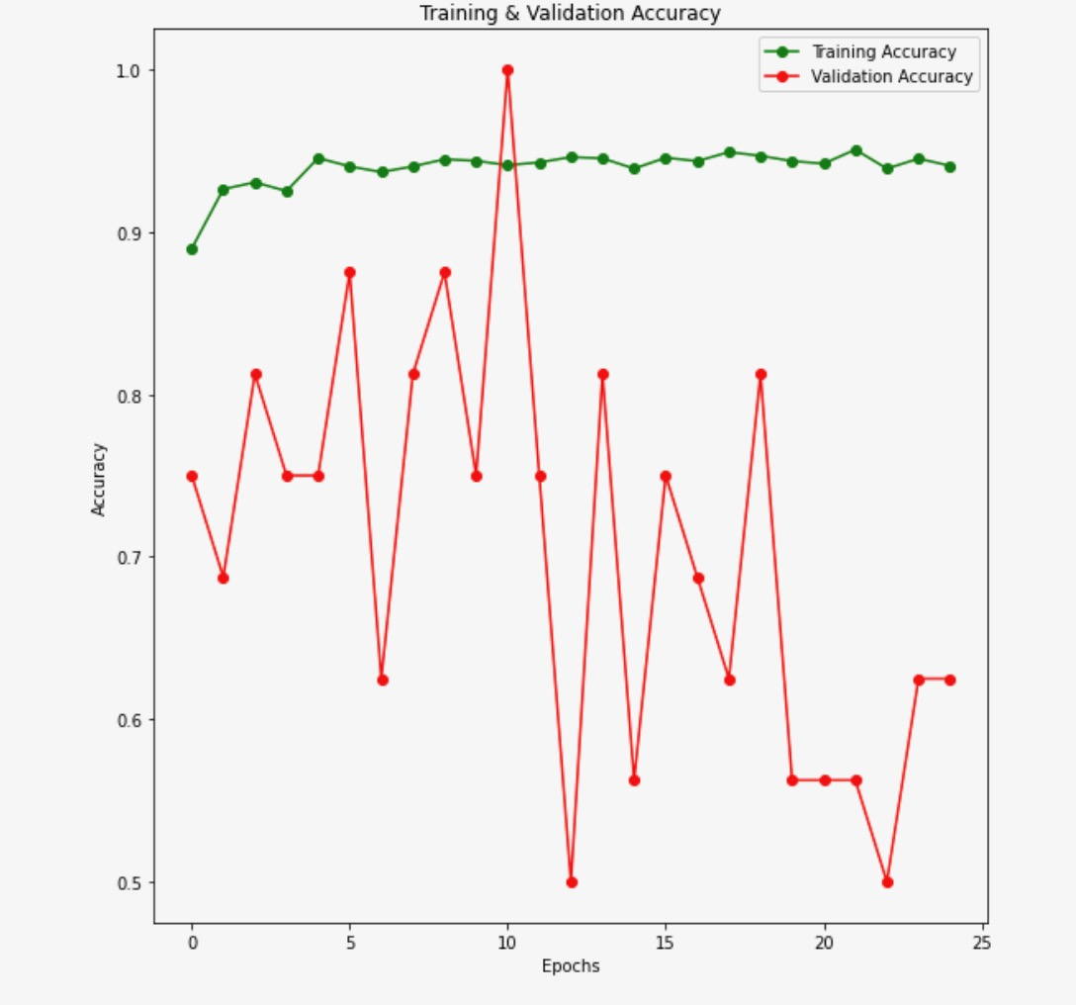
TRAINING & VALIDATION ACCURACY
The plot is illustrating about the training and the validation accuracies that we achieved for the respective sets during the training of the model on 25 Epochs.
On the training set, we can see two spikes in the accuracies in the beginning but, as the number of epochs increases, the accuracy curve starts to flatten, and we didn’t observe any significant changes in the latter epochs.
On the contrary, to the training accuracy, the validation accuracy has a greater number of ups and downs.

Slide 13
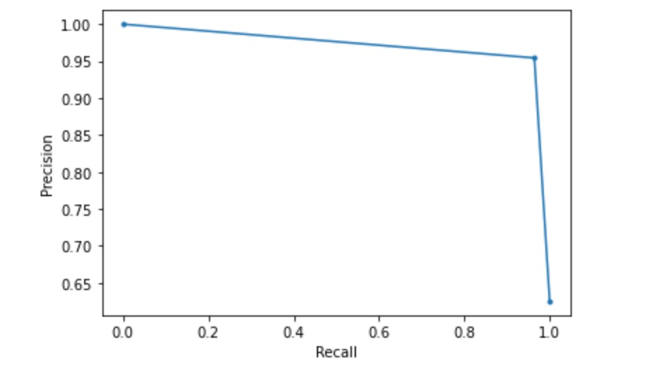
TRAINING & VALIDATION ACCURACY
We can conclude that our model has achieved really good results in terms of precision and recall which is the primary requirement from healthcare data perspective. Due to large number of true positives and very few false negatives which indeed resulted in high recall of 96.4%.

Slide 14
Quantification and Statistical Analysis
On CPU for 1 Epoch took around 30 minutes.
Single GPU on single node for 25 Epoch took 145 minutes 19 seconds.
On 2 GPU’s, 1 Node for 25 Epoch took only 34 minutes 6 seconds. .
ROC curves were generated using classification probabilities of urgent referral versus otherwise and the true labels of each test image and the ROC function of the Python scikit-learn library.
Accuracy was measured by dividing the number of correctly labeled images by the total number of test images

Slide 15
CONCLUSIONS

Slide 16

CONCLUSION 1
The performance of our model depends highly on the weights of the pre-trained model. Therefore, the performance of this model would likely be enhanced when tested on a larger dataset with more advanced deep-learning techniques and architecture.
CONCLUSION 2
Furthermore, we demonstrated
this point by training our network on a dataset of chest X-ray images of pediatric pneumonia. Chest X-rays present a difficult classification task due to the relatively large number of variable objects, specifically the imaged areas outside the lungs that are irrelevant to the diagnosis of pneumonia.

Slide 17
CONCLUSION 3
Training the model on CPU for 1 Epoch took around 30 minutes. While training the model on Single GPU for 1 Epoch, Time dropped significantly and took around only 1.5 minutes. Furthermore, Training the model on 2 GPU’s, 1 Node for 1 Epoch took less than 1 minute. Thus, parallelism may very well be worth due solely to the potential of dramatic time-savings related to algorithm execution. Moreover, modifying algorithms to allow certain of their tasks to take advantage of GPU parallelization can demonstrate noteworthy gains in both task performance and completion speed.

Slide 18
THANK YOU!
Submitted By
Number of students in the Team: 1
Team Member Name : Newzy Sharma
Team Number: 12
For any questions, please contact @
sharma.new@northeastern.edu

